Slide 1
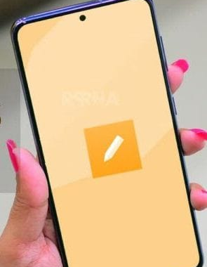
Mobile Application Notes
192011461
m.venugopalreddy

Slide 2
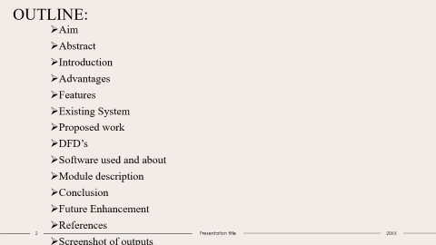
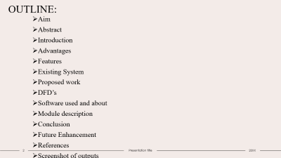
OUTLINE:
Aim
Abstract
Introduction
Advantages
Features
Existing System
Proposed work
DFD’s
Software used and about
Module description
Conclusion
Future Enhancement
References
Screenshot of outputs

Slide 3
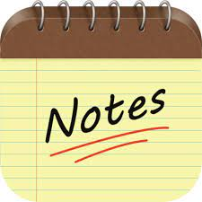
AIM: To make note application using android software

Slide 4
Abstract:
→Taking a note is the process of capturing information in a source or event. This usually takes type of writing, jotting, wording, scanning, labelling and outline.
→Many apps have their own unique features, storage, editing, and sharing capabilities, and so on for the user to see which note-taking app will work best for their needs.
Android Notes app is an Android-based application that is built in the Java.
A completely native app, using the latest features of the Android platform to provide the best user experience. It can be used to store important notes, daily activities, photos etc.

Slide 5
Introduction:
Android Notes Application aims to address the daily problem of taking notes at appropriate times when the event is fast paced and you do not have time to pull out your pen and paper.
This is an Android-based application which is developed in Java.
. It can be used to store important notes, daily activities, photos etc.
The notes app is an application, built for storing information and notes that are important to the person.
It also includes creation, storage, sharing, retrieval and editing notes.
This app can be used to store all notes and information digitally and helps to complete the written process digitally to save a lot of time

Slide 6
Advantages:
It can be accesed easily without internet.
It automatically saves data without any intimation when we come back from it.
Easy to update or insert data in the notes.
Stores unlimited of data.
Can delete the data of notes or whole note can be deleted.
Sorting of data done according to alphabetic order.
Can make note of work to do.

Slide 7
Features
Add note
Title
Content
Update
Delete
Arrangement of titles
Store the data

Slide 8
Existing work:
Works with any android operating system and integrates with your Personal information.
The Android multimedia framework provides built-in support for collecting and storing information as well as updated data.
We required proper xml and java code for Notes Application.
We need to write java code for storing information in the phone memory storage.
After all process we want to run the code.
And connect your mobile with USB cable and download the android quiz app in your mobile phone.After transferring the application to the mobile device we can just open the application and run the code in the mobile phone.

Slide 9
Proposed work:
We are starting with a simple app which some of you must recognize as it used to be the part of phones android made.
Notes application is free and it delivers everything basic users expect from this kind of app.
In just a few steps we have the option to add notes with new title or update of data .
This application records the information of data which has written by the user of some data if the user exits back from the application it may store the data automatically without any information giving to the user
. This application doesn’t have any set of rules,it can unlimited data in one note.it stores all the information in phone memory storage.
so we can add the data until phone memory is full.

Slide 10
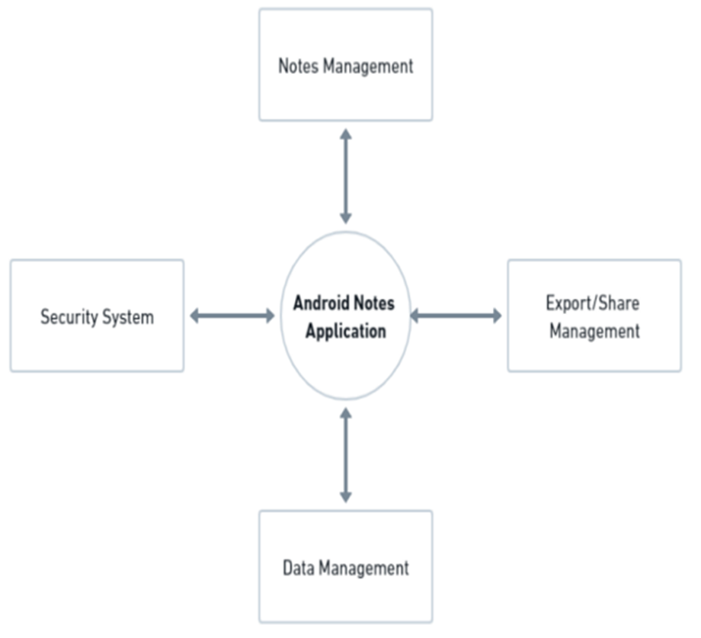
Dataflow diagram:

Slide 11
Software used and about:
Software used is “ANDROID STUDIO”.
Android Studio provides a unified environment where you can build apps for Android phones, tablets, Android Wear, Android TV, and Android Auto. Structured code modules allow you to divide your project into units of functionality that you can independently build, test, and debug.
This runs of java and kotlin language.
It includes still/video cameras, touchscreens, GPS, accelerometers, gyroscopes, barometers, magnetometers, dedicated gaming controls
Permission to install applications over USB and installation from unknown sources from ‘Developer Options’.

Slide 12
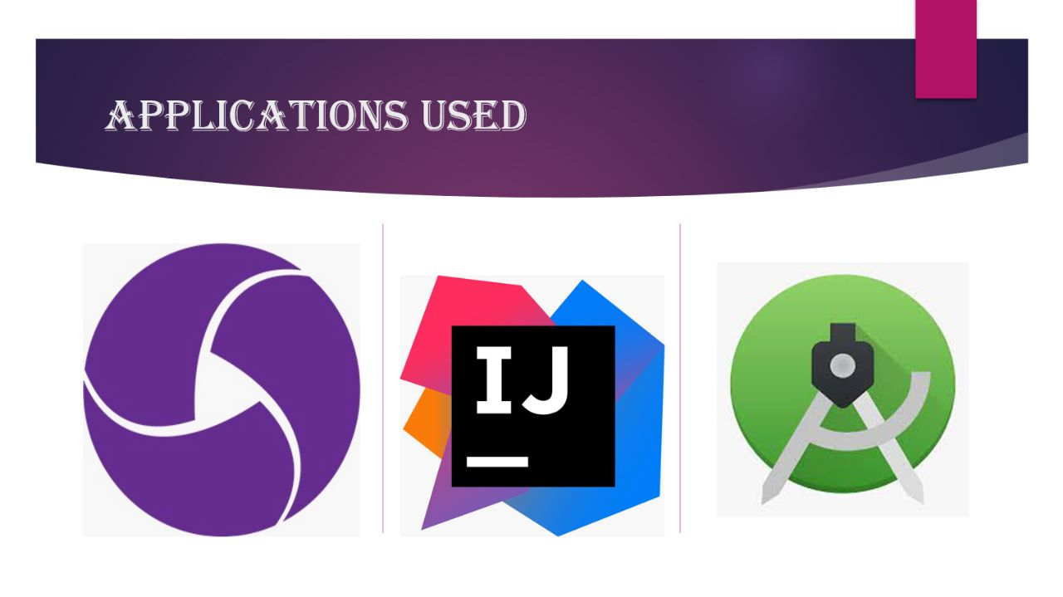

Slide 13
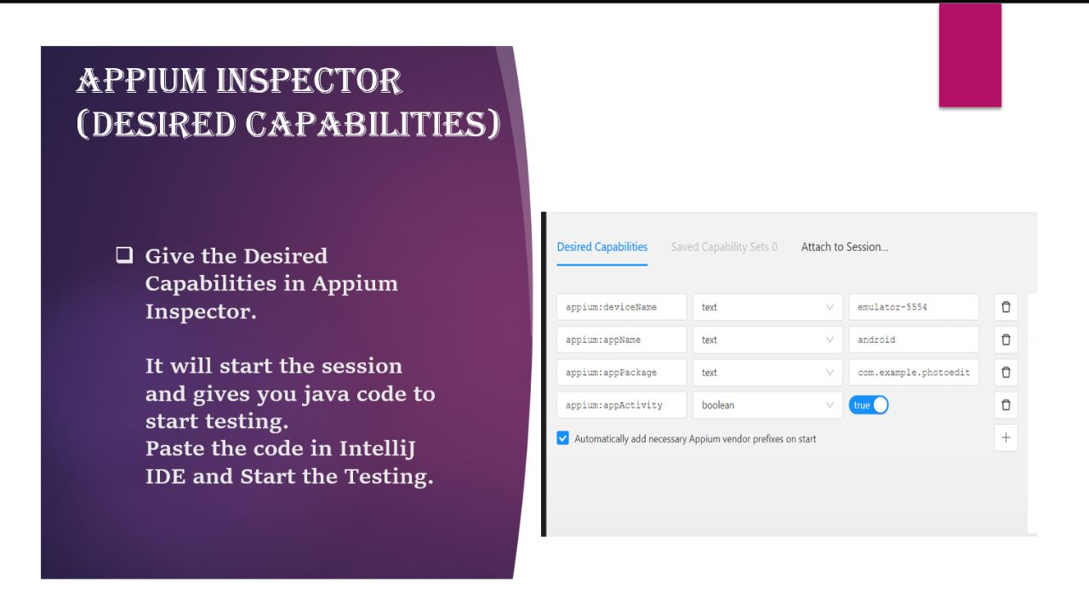
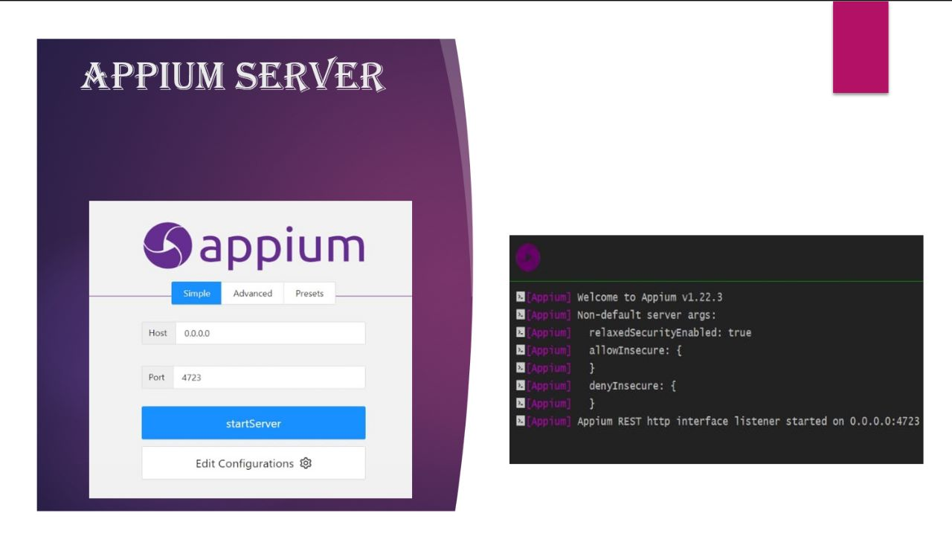

Slide 14
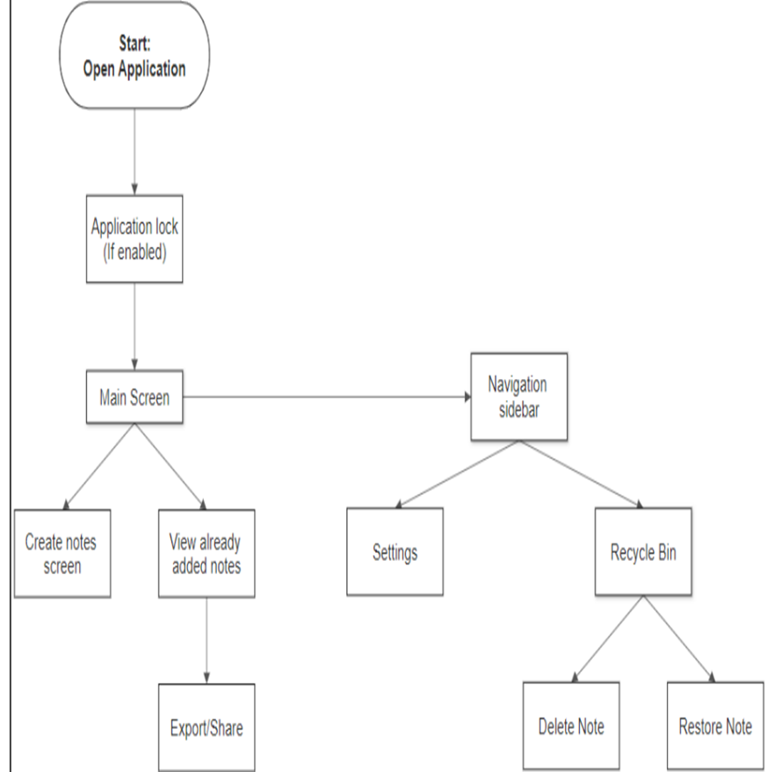
Project work flowchart:

Slide 15
Module description:
Using "Android Notes App" source code package you can create amazing android Notes app. "Android Notes App" source code package is built with latest android studio and is easy to use and configure.
You can store everything from personal thoughts and ideas to business projects, and know they’re always safe and secure, and easily accessible whenever you need them
Can be accesed easily.

Slide 16
Conclusion:
It make easy to the person to open and know about .
As the mobile is easy to carry and can contain more information.
This application is very useful to all kinds of people.
Many students are taking advantage of the electronics in the classroom.

Slide 17
Future enhancement:
The result of Android based Notes app is completely Error free.
This application does not need internet access,but it needs internet for updating new versions.
This application has been developed after the analysing of data.

Slide 18
References:
Culjak, D. Abram, T. Pribanic, H. Dzapo and M. Cifrek, "A brief introduction to OpenCV," 2012 Proceedings of the 35th International Convention MIPRO, 2012, pp. 1725-1730.
Xie, Guobo and Wen Lu. “Image Edge Detection Based On Opencv.” International Journal of Electronics and Electrical Engineering 1 (2013): 104-106.
P. Ganesan and G. Sajiv, "A comprehensive study of edge detection for image processing applications," 2017 International Conference on Innovations in Information, Embedded and Communication Systems (ICIIECS), 2017, pp. 1-6, doi: 10.1109/ICIIECS.2017.8275968. [6] P. Tirodkar, H. Malgundkar, S. Ghadi

Slide 19
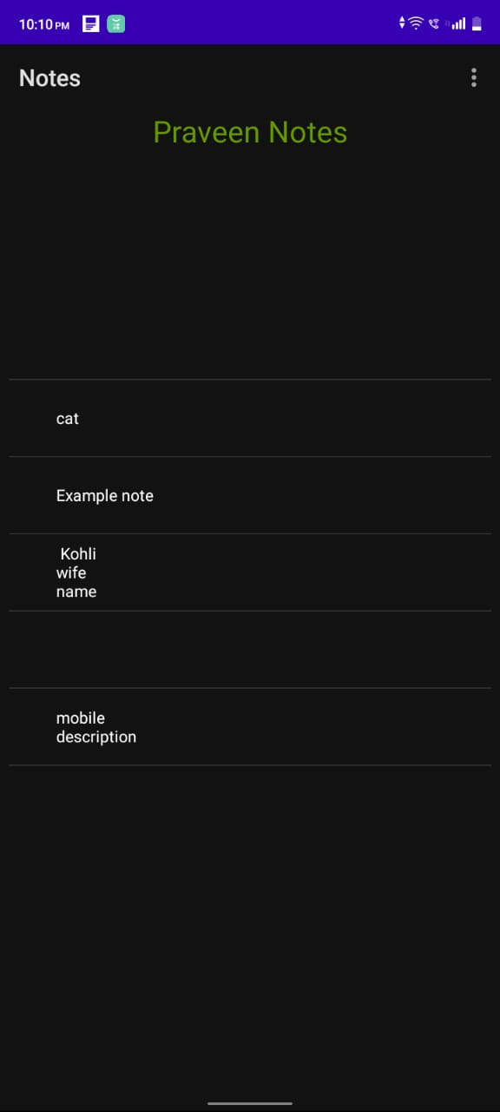
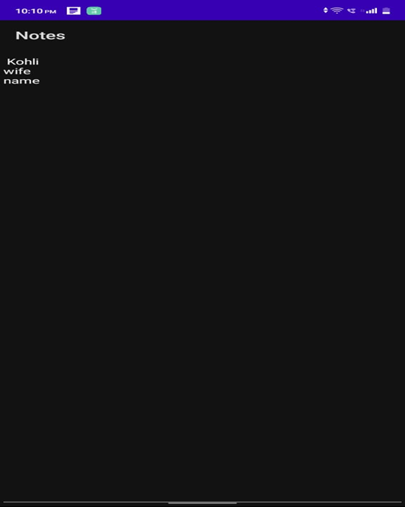
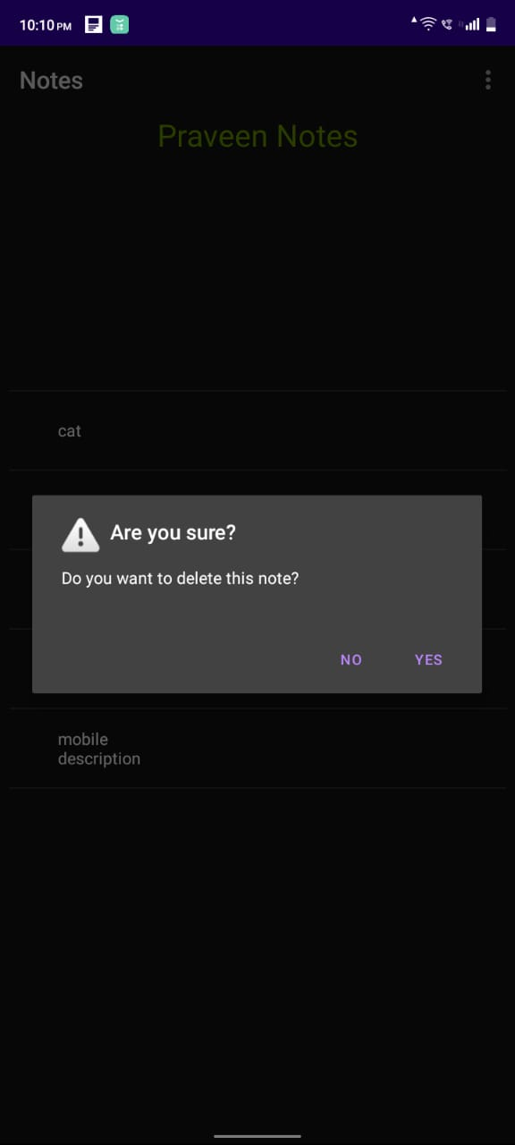
Screenshot of output:
First page
data
delete

Slide 20
Thank you

